Slide 1

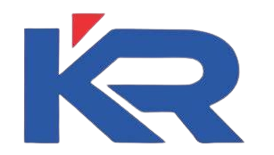
DEPARTMENT OF COMPUTER SCIENCE AND ENGINEERING
20CS8504 & PROJECT WORK
END SEMESTER PRACTICAL EXAMINATION- APRIL / MAY - 2026
Batch No.: 17
Date: 30.03.2026
Session: AN

Slide 2
INTELLIGENT MARITIME SURVEILLANCE SYSTEM USING YOLO ALGORITHM
Guide Name:
Ms. SHAHINA SHALU S
Assistant Professor
CSE
Team Members:
811722104081 – LOGA PRIYA S
811722104108 – POOJA P
811722104115 – PRIYADHARSHINI A
811722104123 – RIFFA INFEE R R

Slide 3
OBJECTIVE OF THE PROJECT
1. To develop an AI-based maritime surveillance system that uses YOLO object detection to automatically detect and track vessels like boats and ships in real-time video streams from cameras or recorded footage.
2. Implement zone-based monitoring, where users can define restricted areas on the video, and the system continuously checks whether any detected object enters or exits these zones.
3. Generate instant alerts with visual indicators and sound notifications whenever a violation occurs, helping authorities take quick action and improve maritime safety and security.

Slide 4
INTRODUCTION
1. Maritime security is a critical concern due to increasing activities such as illegal fishing, smuggling, and unauthorized vessel movement.
2. Traditional surveillance methods rely heavily on human monitoring, which can be inefficient and prone to errors.
3. With advancements in Artificial Intelligence and Computer Vision, automated monitoring systems have become more effective and reliable.
4. This project introduces an Intelligent Maritime Surveillance System that uses real-time video analysis to detect and track vessels.
5. The system enhances security by providing automatic alerts and zone-based monitoring, enabling faster and smarter decision-making.

Slide 5
LITERATURE SURVEY
TITLE OF PAPER | AUTHOR(S) | PAPER GIST | TECHNOLOGY USED
Enhanced YOLO-Based Ship Detection | Bi Zhenbo et al | Improved YOLO model for accurate ship detection in complex conditions | YOLOv5, Deep Learning
YOLO-Based Ship Detection | Redmon et al | Real-time detection of ships using deep learning | YOLO, CNN
Maritime Surveillance using AI | Zhang et al | AI system for monitoring vessel activities | AI, Computer Vision
Vessel Detection using Satellite Images | Qu et al | Detects ships from satellite data | YOLO, Remote Sensing
Smart Surveillance using IoT | Ezzeddini et al | Combines IoT with AI for monitoring | IoT, AI

Slide 6
LITERATURE SURVEY
TITLE OF PAPER | AUTHOR(S) | PAPER GIST | TECHNOLOGY USED
Deep Learning for Object Detection | Girshick et al | Detects ships from satellite data | YOLO, Remote Sensing
Faster R-CNN for Object Detection | Ren et al | Uses region-based CNN for accurate object detection | Faster R-CNN, Deep Learning
SSD: Single Shot MultiBox Detector | Liu et al | Detects objects in a single pass with high speed | SSD, CNN
Deep Learning for Maritime Object Detection | Li et al | Applies deep learning to detect ships in sea environments | Deep Learning, CNN
Video Surveillance using Deep Learning | Sultani et al | Detects abnormal activities in surveillance videos | Deep Learning, Video Analysis

Slide 7
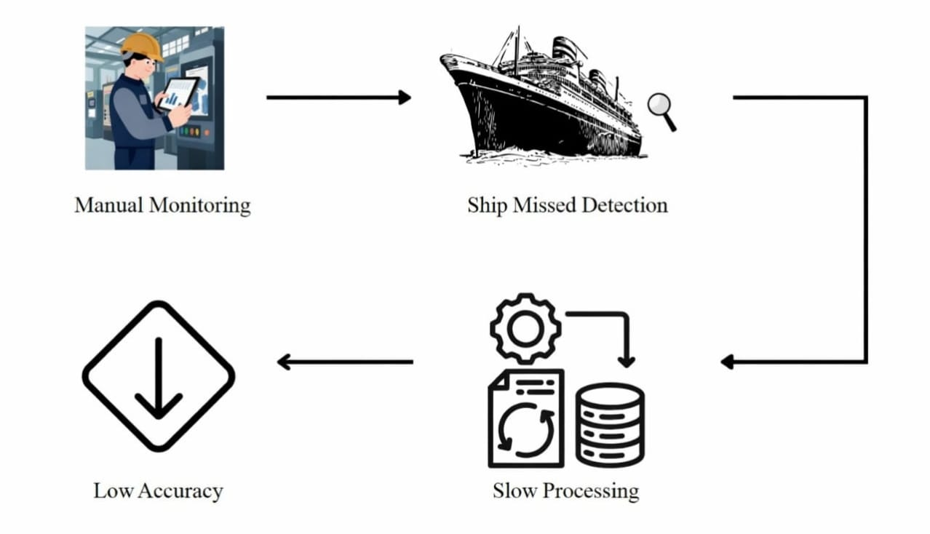
EXISTING SYSTEM ARCHITECTURE

Slide 8
PROBLEM IDENTIFIED
1. Lack of real-time monitoring systems in maritime areas leads to delayed detection of suspicious activities.
2. Heavy dependence on manual surveillance, which is time-consuming and prone to human errors
3. Difficulty in detecting unauthorized entry of vessels into restricted or sensitive zones
4. Existing systems do not provide instant alerts or automated responses during security violations
5. Inefficient tracking and monitoring of multiple vessels simultaneously in large maritime regions

Slide 9
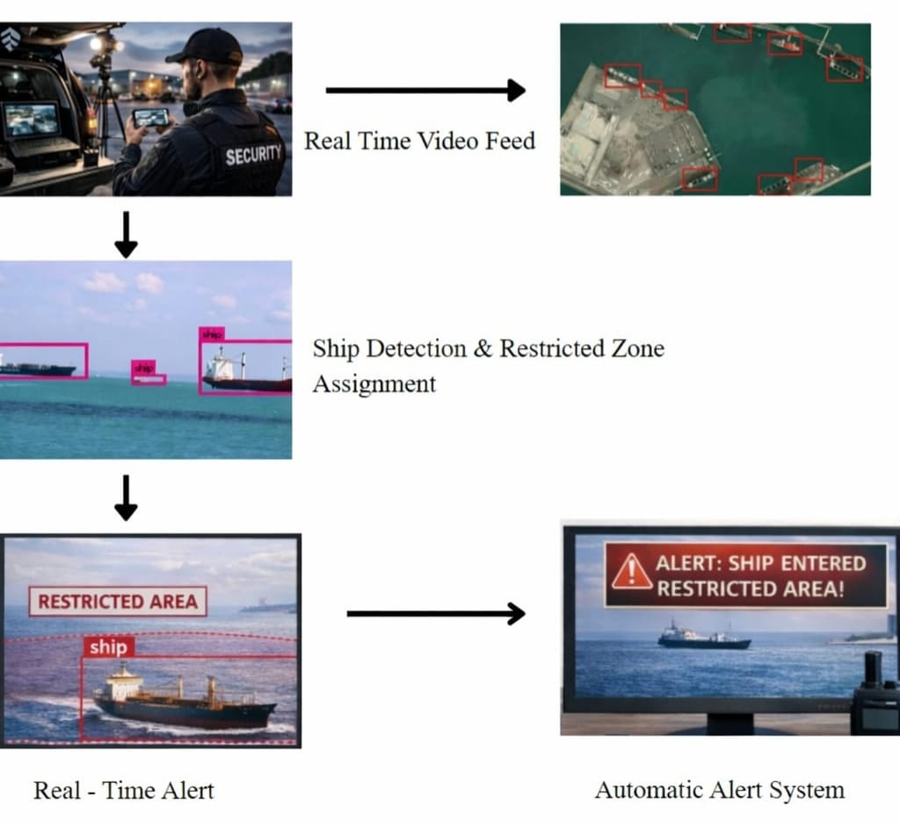
PROPOSED SYSTEM ARCHITECTURE

Slide 10
SOFTWARE AND HARDWARE REQUIREMENTS
HARDWARE
1. Computer/Laptop (i5, 8GB RAM, SSD)
2. Camera (Webcam/CCTV/RTSP)
3. GPU (Optional) & Internt
SOFTWARE
1. Frontend: HTML, CSS, JavaScript
2. Backend: Python / Node.js
3. AI Model: YOLO, OpenCV

Slide 11
MODULES
1. Camera Input Module
2. Object Detection Module
3. Zone Management Module
4. Alert & Notification Module
5. Dashboard & Monitoring Module

Slide 12
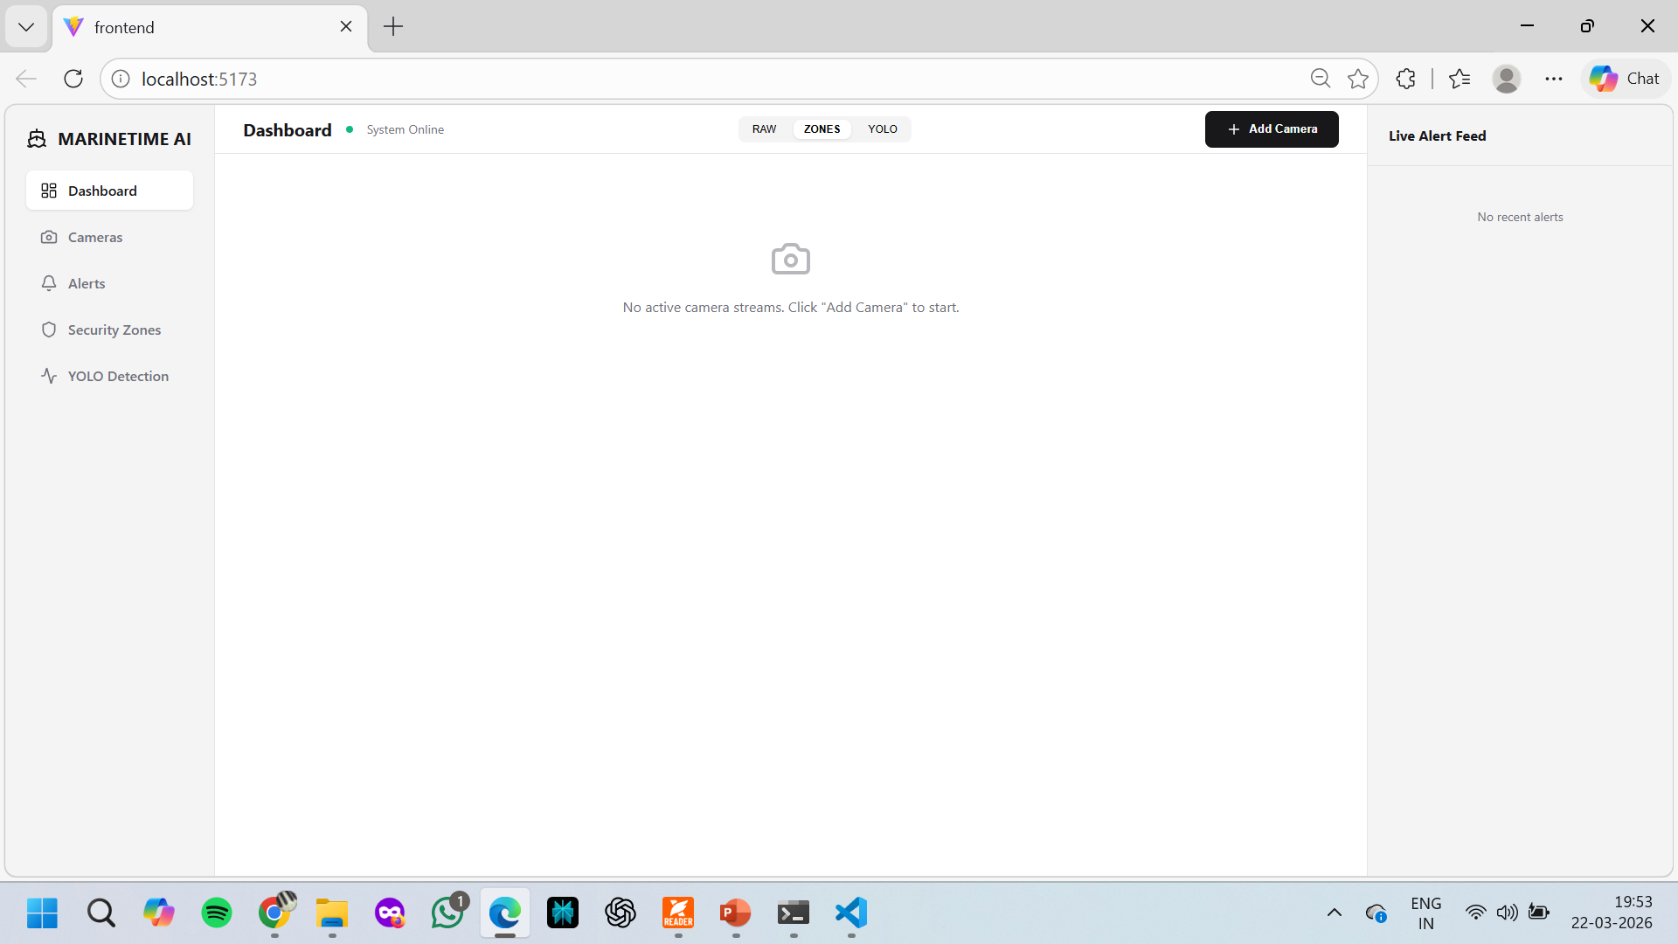
MODULE-1
Camera Input Module :
Handles video input from webcam, CCTV, or RTSP streams.

Slide 13
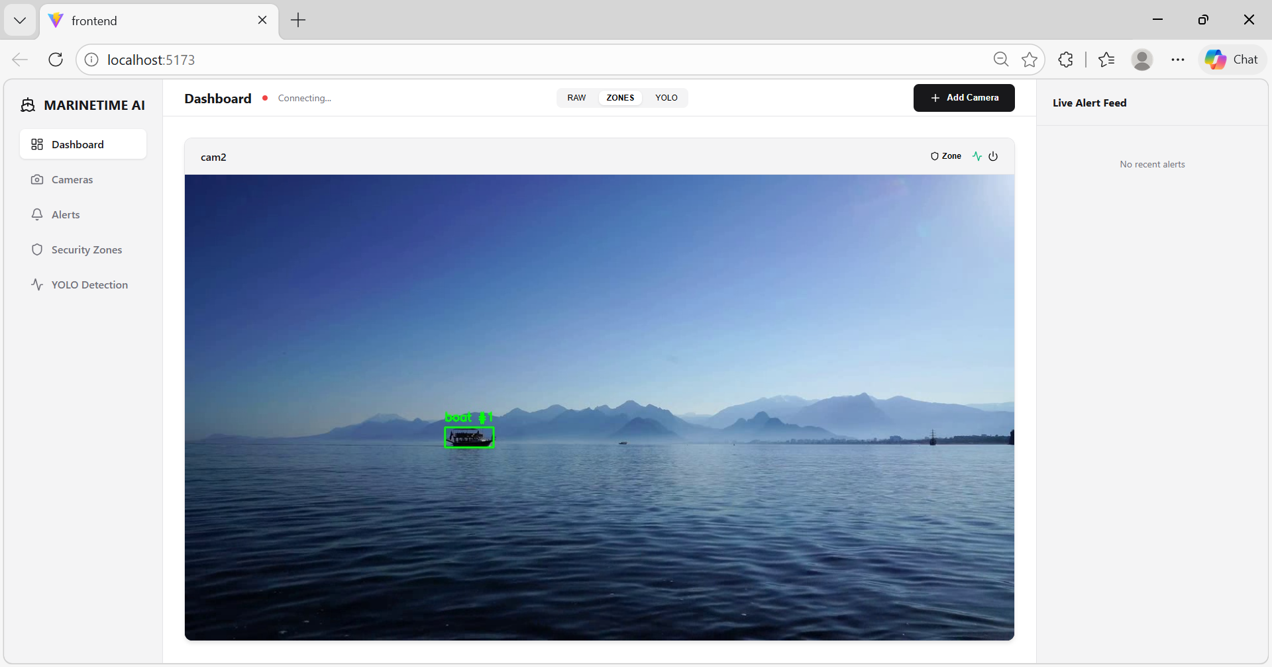
MODULE-2
Object Detection Module :
Uses YOLO to detect and track objects like boats and ships in real time.

Slide 14
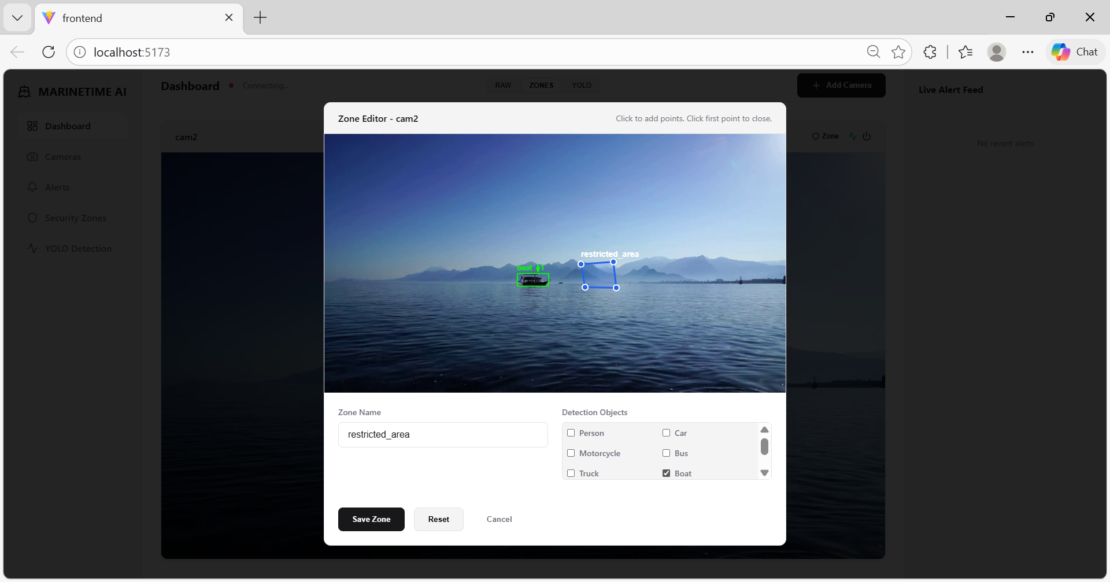
MODULE-3
Zone Management Module :
Allows users to create and manage restricted areas on the video.

Slide 15
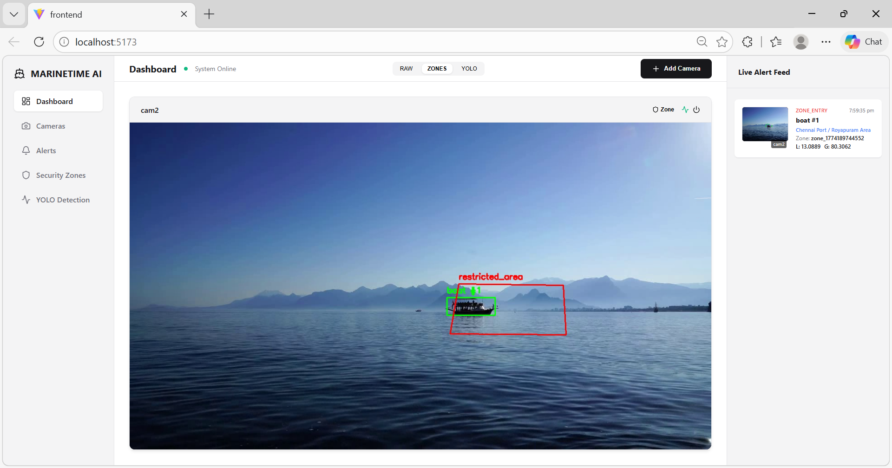
MODULE-4
Alert & Notification Module :
Triggers alerts (visual + sound) when objects enter or exit zones.

Slide 16
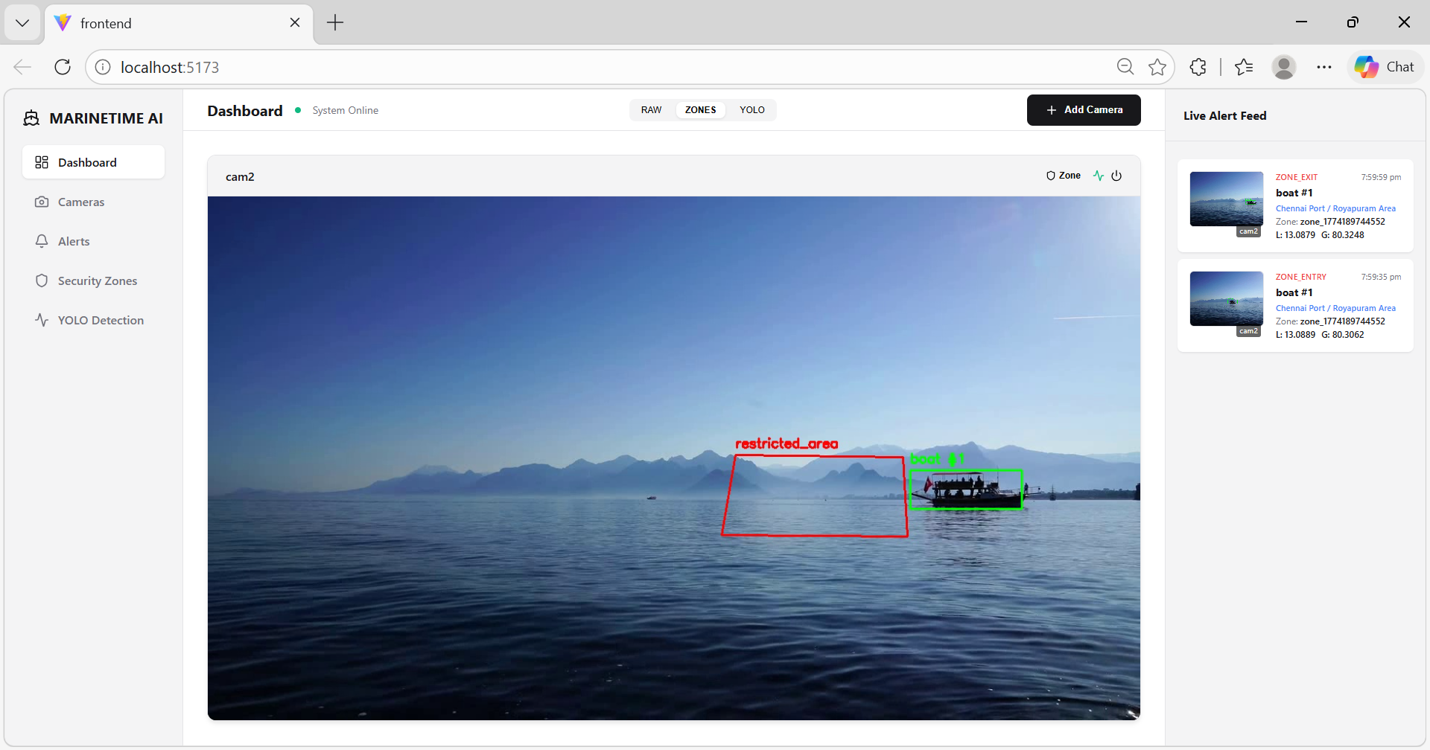
MODULE-5
Dashboard & Monitoring Module :
Displays live video, detected objects, zones, and alert logs.

Slide 17
CONCLUSION
The proposed system effectively integrates AI-based object detection (YOLO) with real-time video monitoring to identify and track maritime vessels, along with zone-based analysis to detect unauthorized movements.
By generating instant visual and sound alerts and providing a live dashboard, the system improves maritime security, reduces human dependency, and enables faster and more efficient decision-making.

Slide 18
FUTURE ENHANCEMENTS
1. Integrate advanced AI techniques and IoT devices such as drones, smart sensors, and satellite data to improve detection accuracy, cover larger maritime areas, and enable more intelligent surveillance
2. Extend the system with multi-camera support, cloud integration, and predictive analytics to store and analyze historical data, detect future threats, and provide scalable remote monitoring solutions.
3. Implement facial recognition and vessel identification systems to automatically identify ships, track ownership details, and detect suspicious or blacklisted vessels.

